Slide 1

Session 3
Organization : TeachToTech
Instructor : Ayush Raj
Duration : 1.5 hr
(knight @leetcode, 4 ★@codechef, Specialist @codeforces)

Slide 2
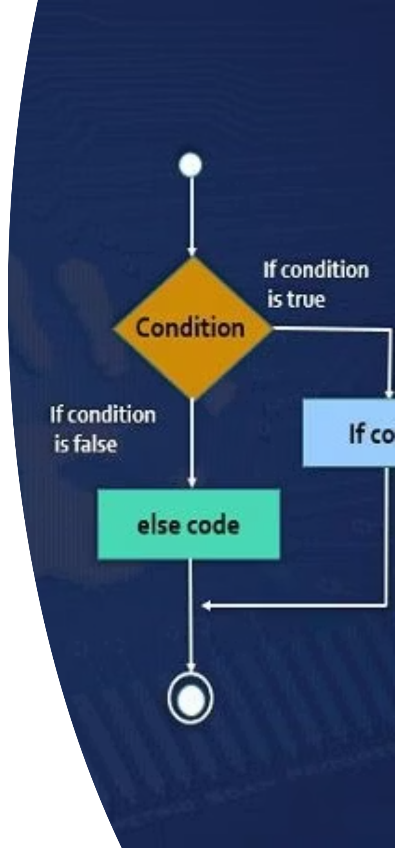
Today's Agenda :
Control Statements
If-Else-If ladder, Switch Case.

Slide 3

How Computers Make Decisions
Sequential Execution
Control Statements
The Analogy
Code executes line-by-line from top to bottom
Allow us to skip lines or choose different paths
Normal code is a straight road; control statements are crossroads with signs

Slide 4
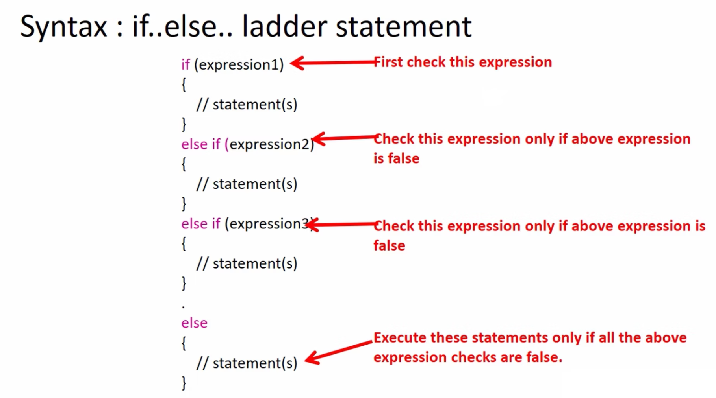
The if-else Ladder
Syntax Structure
Live Demo Challenge
Write a program that takes marks and prints "Pass" or "Fail"
if (condition) {
// Runs if True
} else if (other_condition) {
// Runs if 1st was False
// but this is True
} else {
// Runs if nothing else
// was True
}

Slide 5
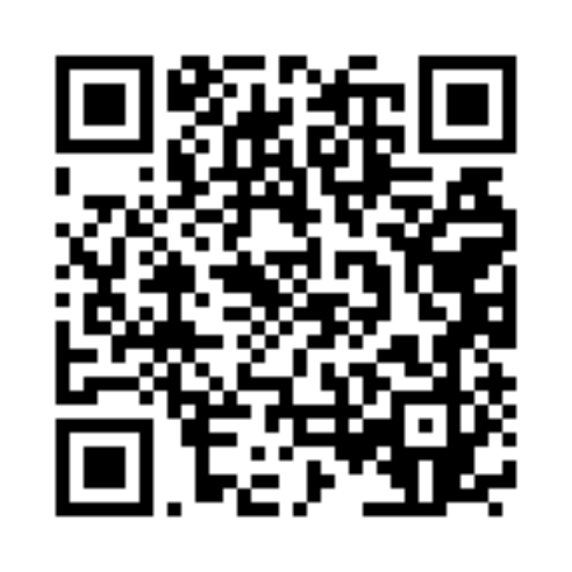
Problem Solving: Power of Two
LeetCode 231
The Problem: Given an integer n, return true if it is a power of two (1, 2, 4, 8, 16...)
Problem 1
Power of Two - LeetCode
Approach : Bitwise Trick
Recall Session 2: Powers of 2 have exactly one '1' bit (e.g., 8 is 1000).
Why does it work? If n=8 (1000), then n-1=7 (0111). 8 & 7 becomes 0.
Logic: if (n > 0 && (n & (n - 1)) == 0)

Slide 6
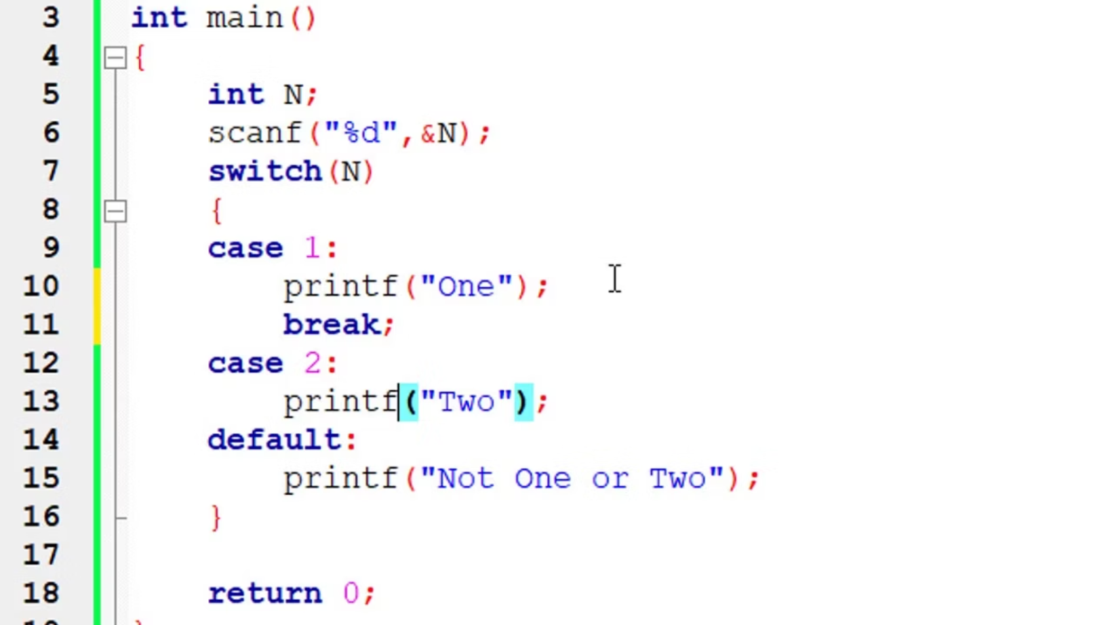
The switch Statement
Why use it?
Syntax Components
When you have many specific options (like a menu), it's cleaner than writing 50 else if statements.
switch(expression): The variable to check
case x:: If variable == x, do this
break;: Stop! Don't run cases below
default:: If no cases match (like else)

Slide 7

Activity: Menu Driven Program
Create a Mini-ATM
Check Balance
1
Display current account balance
Withdraw Money
2
Deduct amount from balance
Deposit Money
3
Add amount to balance
Exit
4
Close the program
Your Task: Students write the switch block to print messages for each choice

Slide 8

Key Takeaways
if Statements
switch Statements
Problem Solving
Check conditions and execute code based on True/False evaluation
Check equality against specific values - cleaner for multiple options
Multiple approaches exist - consider efficiency and readability

Slide 9

Homework & Practice
1
2
Leap Year Checker
Traffic Light Simulator
Write a program to check if a year is a leap year using if-else statements
Create a simulator using switch statement:
R = Stop
G = Go
Y = Wait
Practice makes perfect! Complete both assignments before the next session.

